Slide 1


Social Buzz
project

Slide 2


Today's agenda
Project recap
Problem
The Analytics team
Process
Insights
Summary

Slide 3

Client: Social Buzz is a social media platform, founded in 2010, emphasizes user reactions and anonymity. It's rapidly grown to over 500 million monthly active users.
Needs: Assistance with IPO preparation, managing growth, and adopting data best practices.
Objectives: 3-month project to audit big data practices, offer IPO recommendations, and analyze top-performing content categories.
Project Recap

Slide 4


Problem
Rapid Growth Straining Resources: Social Buzz's rapid expansion has outpaced the internal capabilities, creating difficulties in managing operations effectively.
Data Management Challenges: The vast amount of data generated daily poses challenges for Social Buzz's infrastructure, hindering ability to handle and analyze efficiently.
Scale Management Struggles: Social Buzz is grappling with the immense scale of operations, requiring external expertise to navigate and optimize processes.

Slide 5



Ira Safonik
(Data Analyst)
Marcus Rompton (Senior Principle)
Andrew Fleming (Chief Technical Architect)
The Analytics team

Slide 6
Data Selection: Identified the relevant datasets - Reaction, Content, and Reaction Types - based on the provided data model and the client's requirement for analyzing content categories.
Process
1
Data Preparation: Cleaned the data by removing any missing values, ensuring consistency in data types, and selecting only the necessary columns for analysis. This involved filtering the datasets to include columns such as Content ID, Category, Content Type, Reaction Type, and Reaction Score.
2
3
Data Aggregation: Aggregated the data to calculate the total score for each content category. This was achieved by summing up the reaction scores for each content category across all reactions.
Ranking Categories: Identified the top 5 content categories with the largest total scores, indicating their popularity based on user reactions.
4
5
Visualization: Presented the findings using visualizations such as bar charts or tables to clearly illustrate the popularity of the top 5 content categories.

Slide 7

Insights
The insights gained from this analysis include:
Top Performing Content Categories: Identification of the top 5 content categories with the largest total scores, indicating which types of content are the most popular among users.
Understanding User Engagement: Insights into which content categories receive the highest level of engagement from users, as measured by the total reaction scores.
Content Strategy Optimization: Guidance for optimizing content strategy by focusing on the most popular categories that resonate the most with the audience.
Content Creation Prioritization: Direction for prioritizing content creation efforts towards the identified top-performing categories to maximize user engagement and interaction.
Informing Business Decisions: Data-driven insights that can inform strategic business decisions related to content creation, marketing campaigns, and overall platform development to better meet user preferences and drive growth.

Slide 8
Insights
16
Unique Categories
1897
reactions to `Animals` post
74 965
total score of `Animals` post

Slide 9
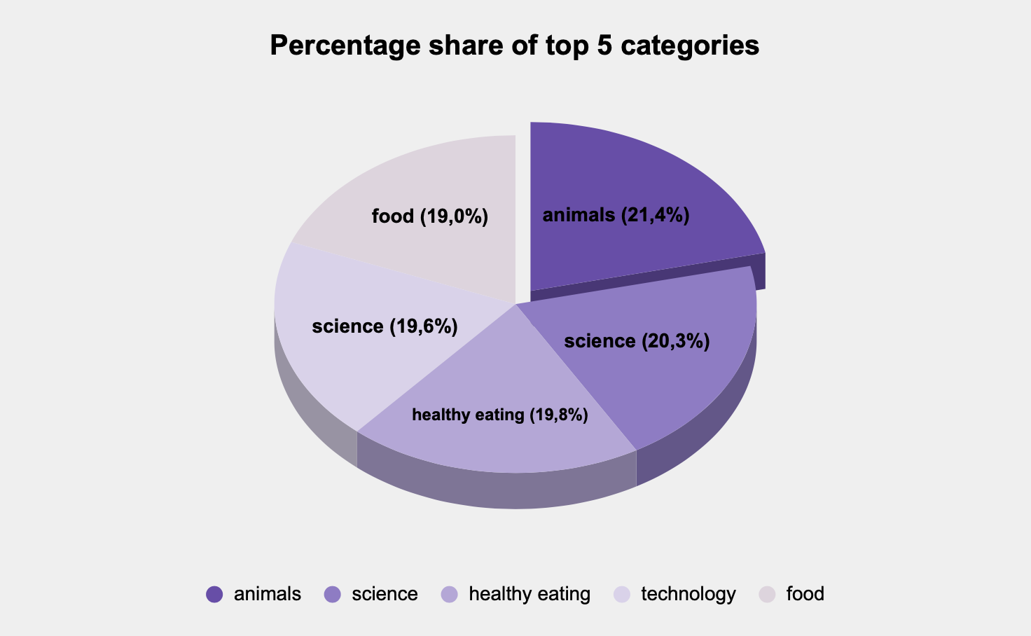

Slide 10
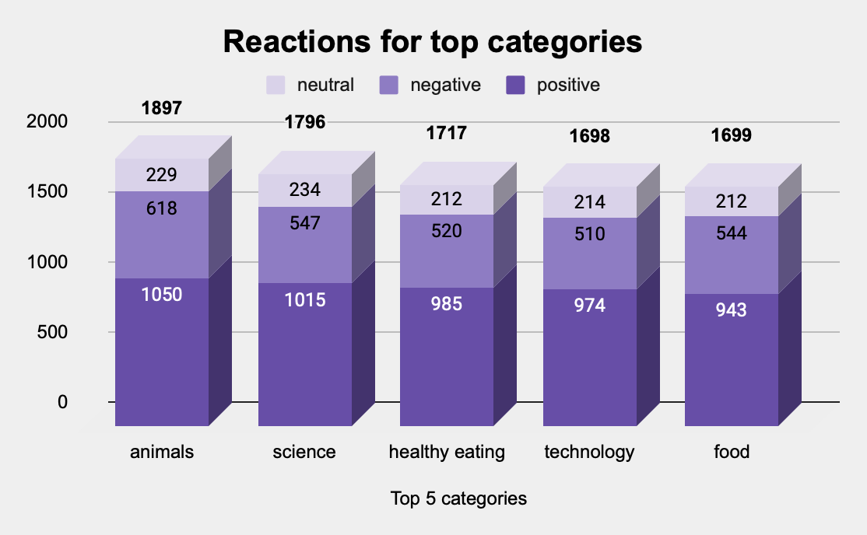

Slide 11
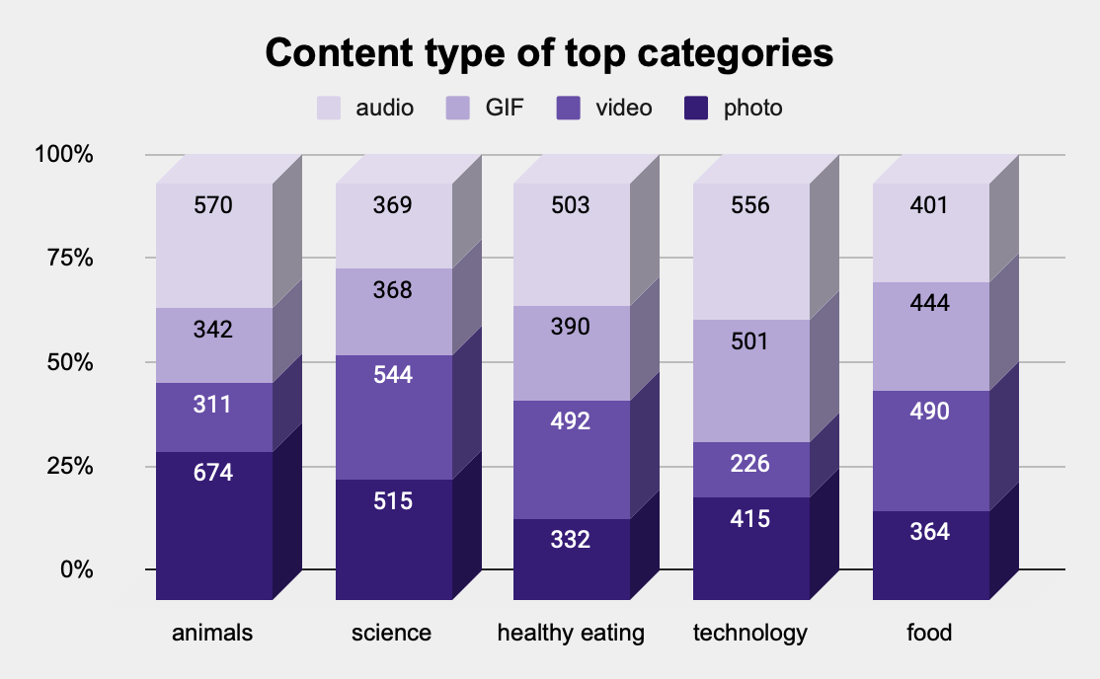

Slide 12

The analysis revealed the top 5 content categories with the highest popularity based on user reactions.
These insights provide guidance for:
optimizing content strategy;
prioritizing content creation efforts;
informing strategic business decisions to enhance user engagement
drive platform growth.
Summary

Slide 13

Thank you!
ANY QUESTIONS?

